Slide 1
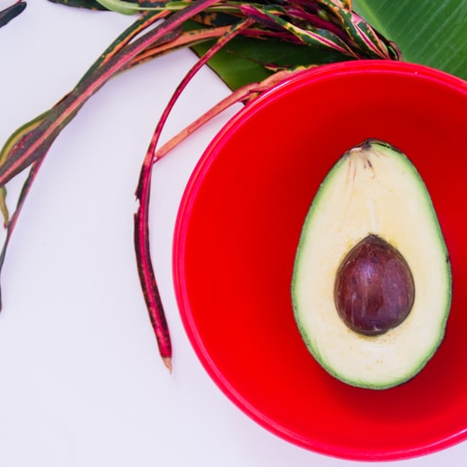

Avacado Sales
Predictive Analysis
23-04-2020

Slide 2
Business Goal
Investment Guidelines
->Demand Analysis (Geo.)
->Type
->Packaging

Slide 3
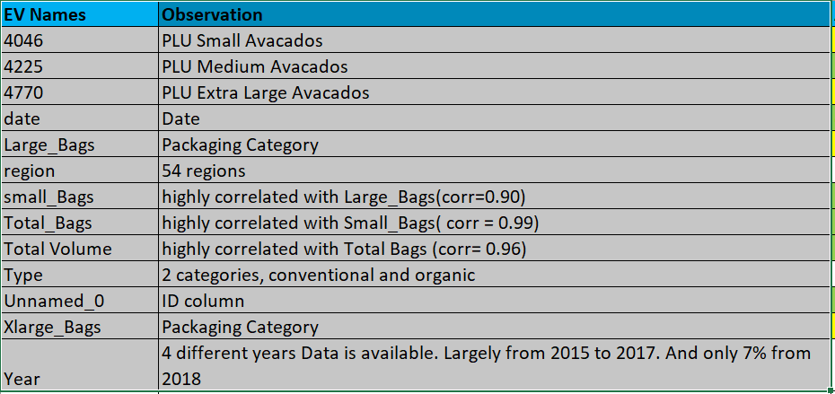
About Data
HASS Categories(Small/Medium, Large and Extra Large)
4 Years(2015 to 2018)
Regions(54)
Packaging(small_bags, large_bags, extra large_bags)
Type of cultivations(Organic/Conventional)
Data has 18249 rows
12 Explanatory Variables and Average Price as Target Variable
No missing Values

Slide 4
Trend Analysis

Slide 5
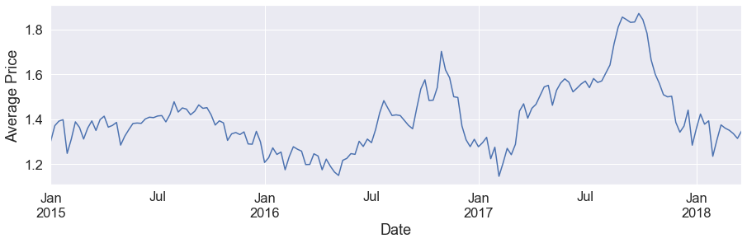
Average Price over years(2015 to 2018)

Slide 6
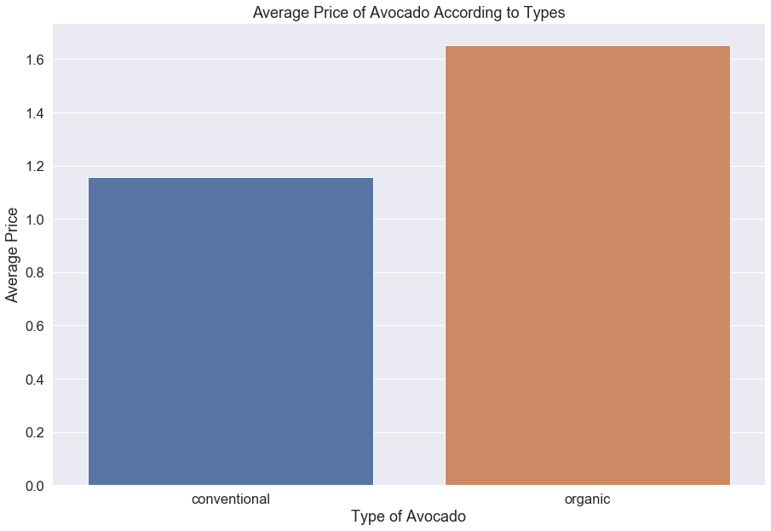
Type of Avacados and their average market Prices

Slide 7
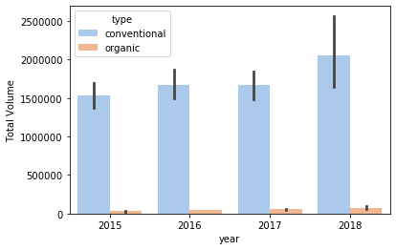
Demand Analysis of Different Types of Avacados across all years

Slide 8
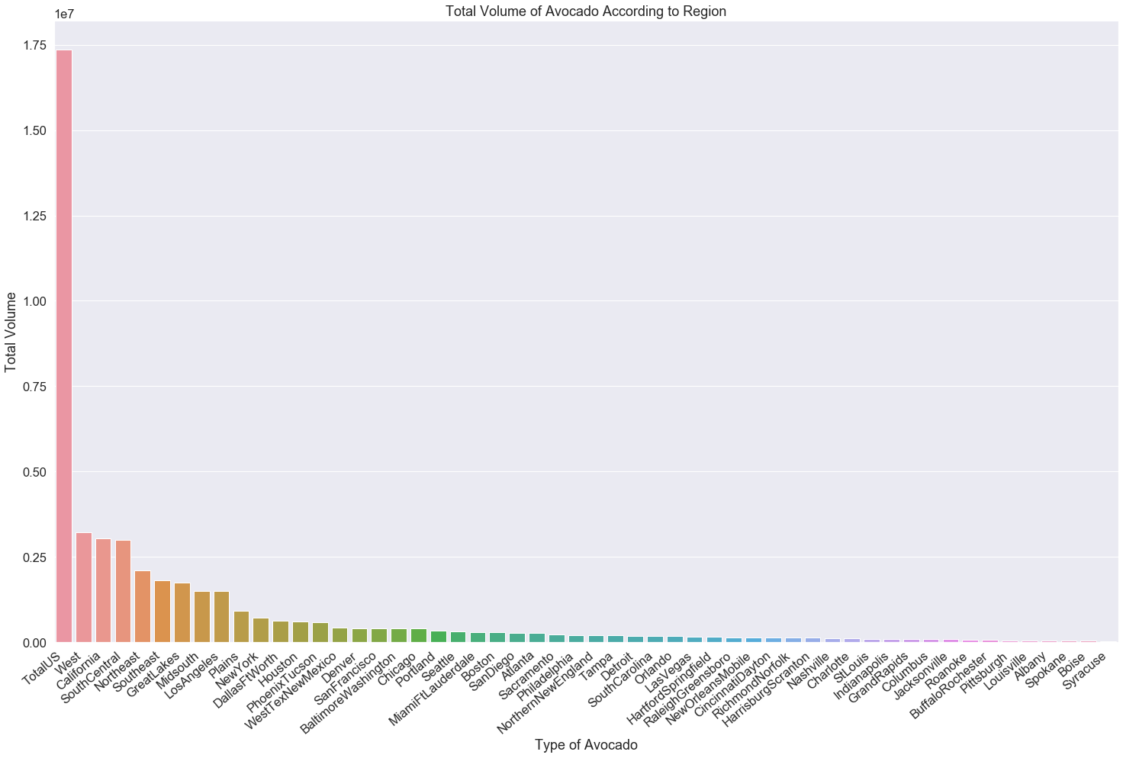
Region wise sale

Slide 9
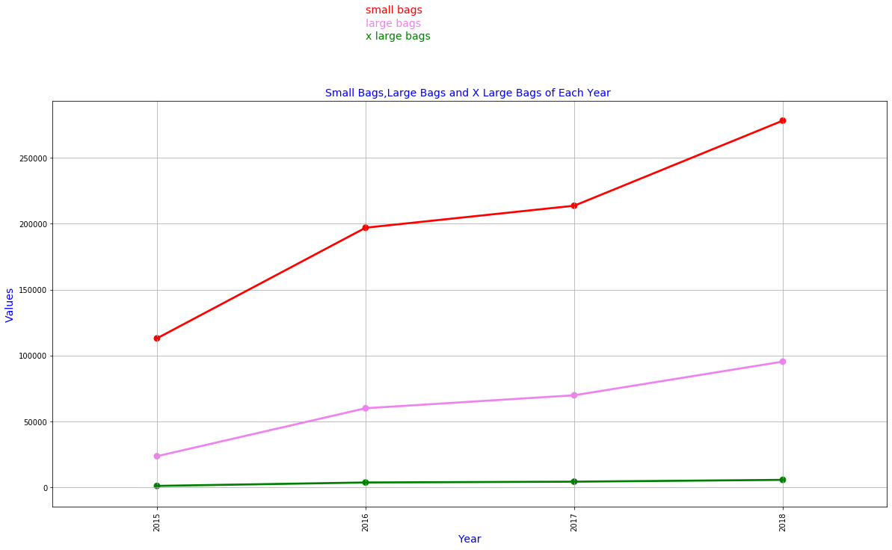
How Packaging affects?

Slide 10
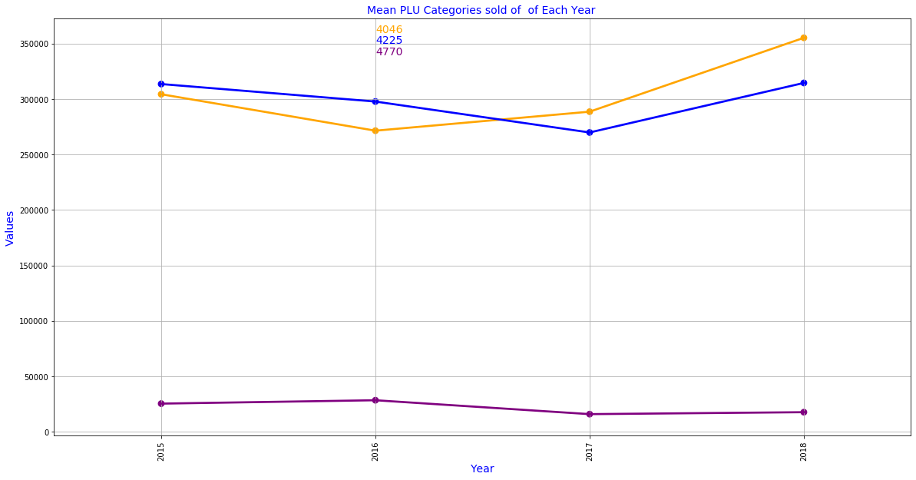
Analyzing PLU categories

Slide 11
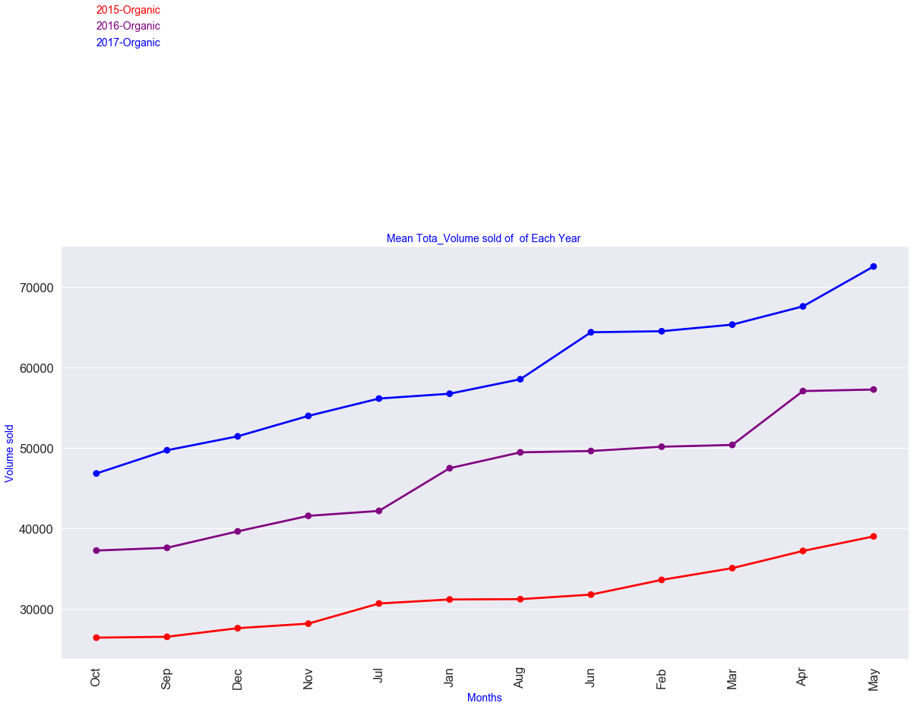
Monthly Sale (2015,2016,2017)

Slide 12
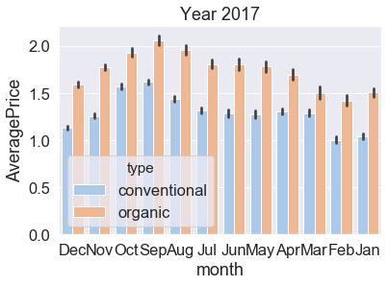
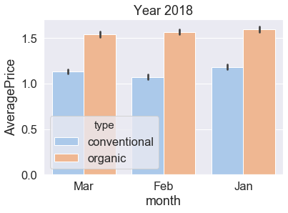
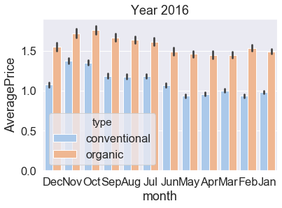
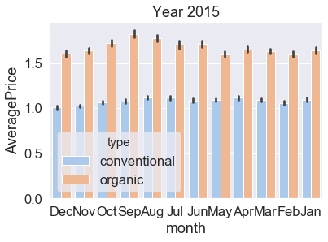
Yearly AVERAGE PRICE for both categories(seen across months)

Slide 13
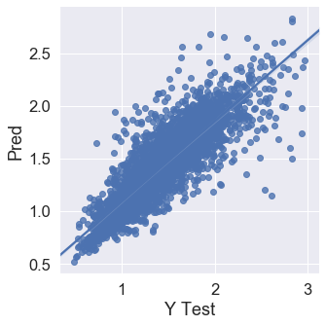
LINEAR REGRESSION RMSE-0.29013 DECISION TREE REGRESSOR MAE-0.177 MSE-0.073 RMSE-0.27 RANDOM FOREST REGRESSOR MAE-0.14 MSE-0.04 RMSE-0.20
MODEL EVALUATION
The above graph between Predicted value of target variable and actual value of target variable on Test data. It shows that most of the points are concentrated at the line of best fit. So, our model has made good prediction with a rmse of 0.20.
Random Forest has reaped in best results for this data set.

Slide 14
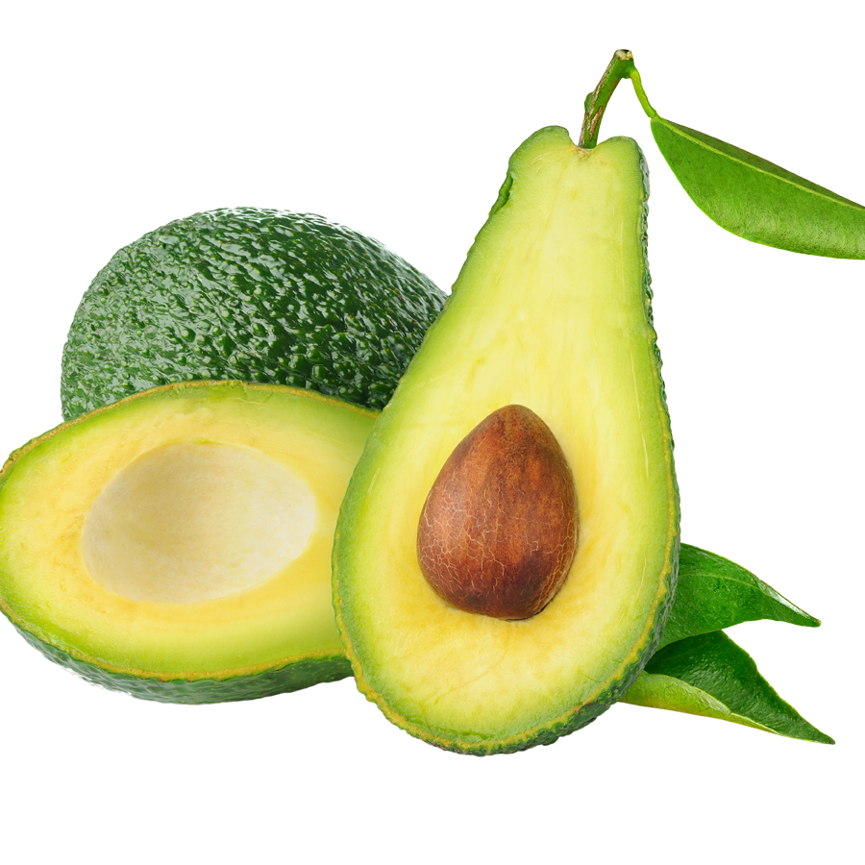
Investing in Avacado Market in US can reap good profits. As yearly trend shows increasing demand of Avacados Small Packs are in high demand as opposed to XLarge Packets Price of conventional avacados is much lesser than oragnic avacados, and demand for conventional avacados is much more than organic ones While analysing the HASS category of Avacados, we found that small and medium show increasing demands. But the Extra Large Avacados shows constant demand only. Total US has the extremely high demand as compared to other regions It's not a good choice to invest in below regions Jacksonville Roanoke
BUSINESS INSIGHTS
This Photo by Unknown Author is licensed under CC BY-NC

Slide 15
THANK YOU

Slide 16
Suggestions/Improvements
Please Write to goldyjnu@gmail.com

